Slide 1
Yealink T54W Phone Training
Notes:
Welcome to your MetroNet Yealink T54W Phone Training.

Slide 2
Phone Buttons
Screen Features
Call Handling
Training Topics
Notes:
We will talk about many features and functions of your phone such as your phone buttons, screen features and call handling.

Slide 3
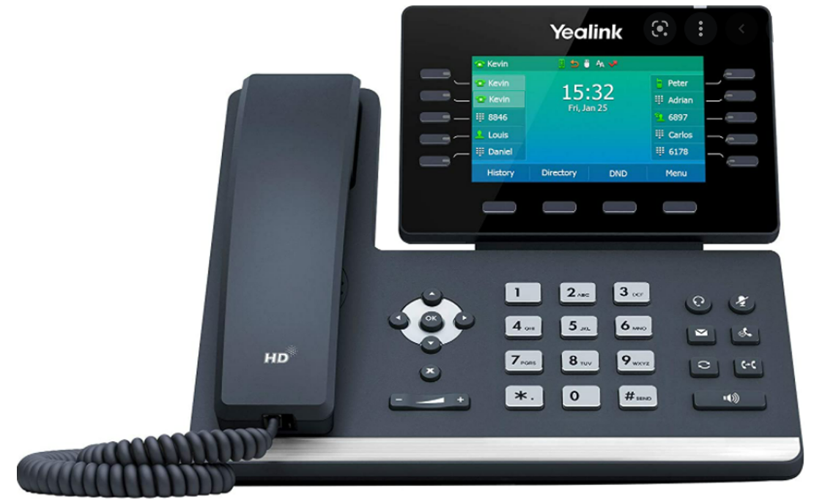
Button Basics – Line Keys
Line Keys:
Buttons that represent your individual line/extension
Line Keys:
Programmable keys that can be used for:
Speed Dials
Enhanced Monitored Exts.
Line Keys:
Programmable keys, typically used for Park Orbits
Notes:
The keys to the left and right of the screen are your line keys and can be used for many functions. The top left key will always be the line assigned to that phone. The rest of the keys can be used for speed dials, park orbits, or Enhanced Monitored Extensions. We will talk more about Enhanced Monitored Extensions and Park Orbits later in this discussion. These buttons are customizable so if you find you want buttons programmed, please let your administrator know or contact your Project Manager here at MetroNet for assistance.

Slide 4
Button Basics – Soft/Hard Keys
Soft Keys
Preset keys to access functions and change depending on what you are doing at the time:
History
Directory
DND
Redial
Transfer
Conference
Hard keys
Programmed for specific function and do not change.
Headset
Mute (lights up red when active)
Message Key
Hold
History/Redial
Transfer
Speakerphone (lights up green when active)
Notes:
The soft keys at the bottom are not programable but will change depending on what you are doing. The default screen will show History, Directory, DND and Menu. History will show all missed calls, placed calls, received calls, and forwarded calls. Directory will show numbers you want stored to be dialed at any time you select the desired entry. DND for when you do not want to be disrupted. Any incoming calls will go straight to your voicemail. Menu offers additional options such as your phones Basic settings (language, ring tone, USB. You will see the hard keys beside the dial pad will duplicate some of the call functions found on the display screen.

Slide 5
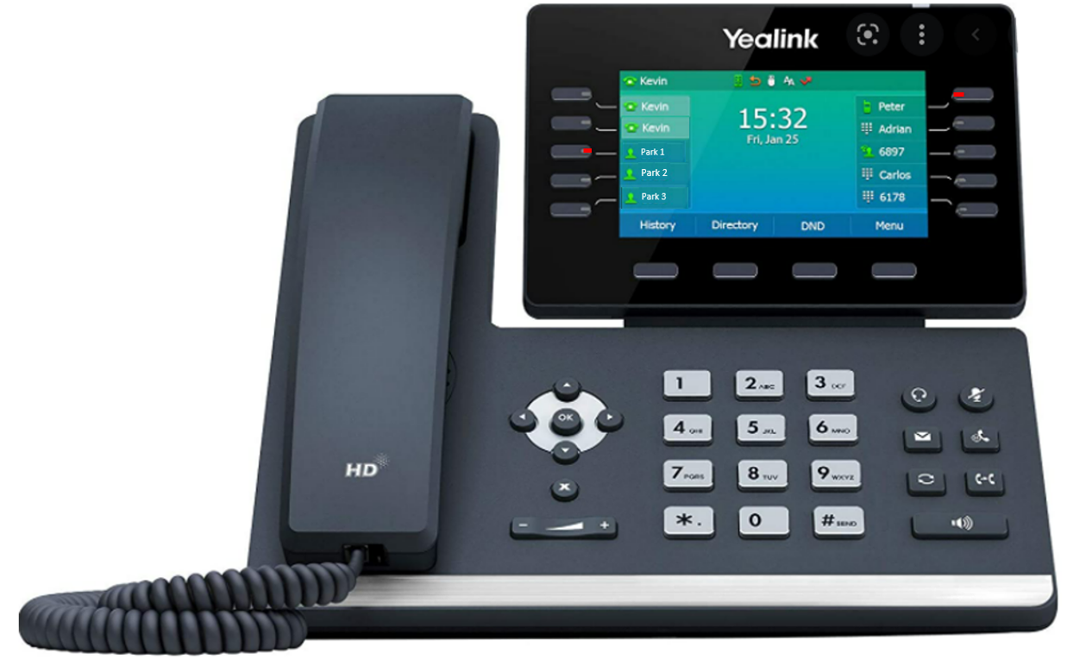
Button Basics – Functionality
Buttons will light up when in use:
Park Orbits will be lit when a call is parked.
Monitored extensions will be lit when that person is on their line.
Park:
This is used as a “global hold” for your group. A call can be placed on “hold” and that button will blink on all phones. To pick up that call from another phone, simply press that park button.
Monitored Extension:
Shows when another line is in use and can also be used to call that person.
Notes:
As mentioned earlier, you may notice you have 2-3 Park buttons, or Park Orbits. These buttons will light up when a call is “held” and the call can be picked up from any phone within your business group by pressing that blinking Park button. There is a built-in 2 minute timer for that held call. If the call is not picked up within that 2 minutes, the call will ring back to the phone that placed the call on park and will ring and ring until answered. It will not go to that phone’s voicemail. Enhanced Monitored Extensions are buttons for another users line. The button will be lit when the user is on an active call and it can also be used to call that person when not in use. Again, if you want such buttons programmed, please see your system administrator or contact your Project Manager. These are items I can also assist you with as you discover the need over the next few days.

Slide 6
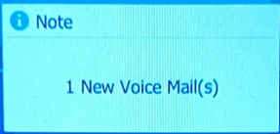
Button Basics – Functionality
Voicemail:
This button is used for the initial setup of your voicemail and for the retrieval of voicemail messages.
If you have messages in your voicemail, the light at the top of the screen will blink to notify you.
Note: The blinking LED will also blink to notify you of missed calls. To clear this notification, simply view your history and it will reset the count. This notification can be disabled.
Notes:
The LED lamp at the top right corner of the display panel will blink to notify you that you have new voicemail messages but if not previously discussed with your Project Manager, the default is also set to blink to notify you of missed calls. This would mean that if you missed a call and the caller left a message, you could listen to that message and the lamp would still blink until you have viewed your missed calls. This missed call notification can be disabled if it has not already been disabled for you. To view your missed calls, simply press the History button at the bottom of your display screen, then back out to your Home screen and the notification will disappear.

Slide 7
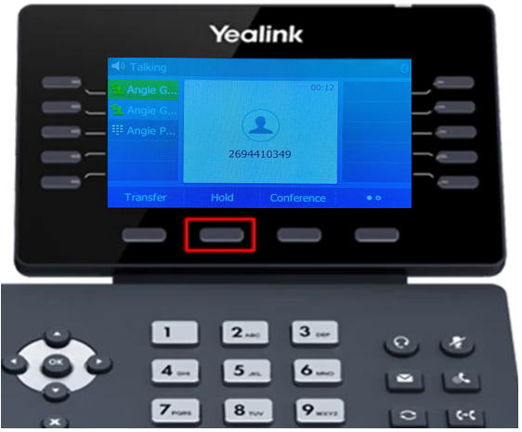
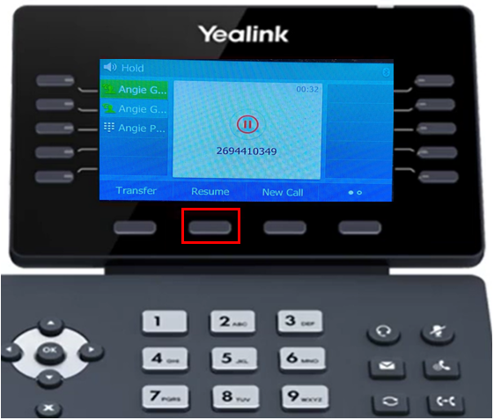
Hold / Resume
Holding a call and Resuming a held call can be achieved by either pressing a soft key or a hard key.
Soft keys change and your options will be present at the bottom of the screen depending on the function you are trying to perform
Notes:
As mentioned earlier, you will find some of the functions offered in the soft keys duplicated in the hard keys. Hold and Resume is an example of that. While in an active call, you will see Hold as an option in the keys at the bottom of the display screen. You can press that button or you can use the hard key below the mute button, found to the right of the dialpad. Either option works the same so there is no difference, it is all in your personal preference. Resuming a held call is the same. You can use the soft key or the hard key to resume the held call.

Slide 8
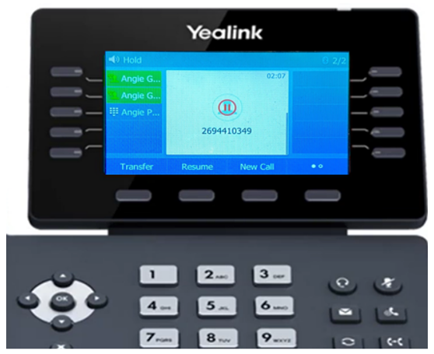
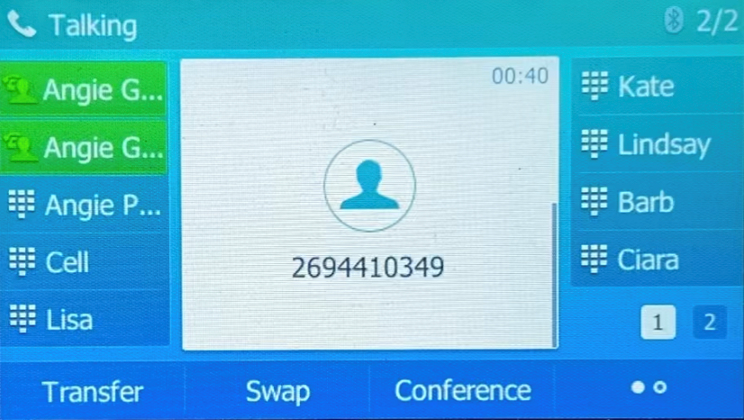
Hold / Resume – Multiple Calls
For multiple calls that are held, to resume, you can:
Use your navigation keys to arrow up or down to select the call you want to resume, then press the Resume soft key or hard key; or
Press the Swap key at the bottom of the screen. This function will toggle back and forth between held calls.
Notes:
If your Yealink only has one button for your line, you will see both calls held on your screen and use your toggle buttons to the left of the dialpad to select the call and select Resume. In this example, where there are two buttons for your line, you can use the Swap button to toggle back and forth between the calls. Each time you press swap, your active call is placed on hold and the previously held call is now active.

Slide 9
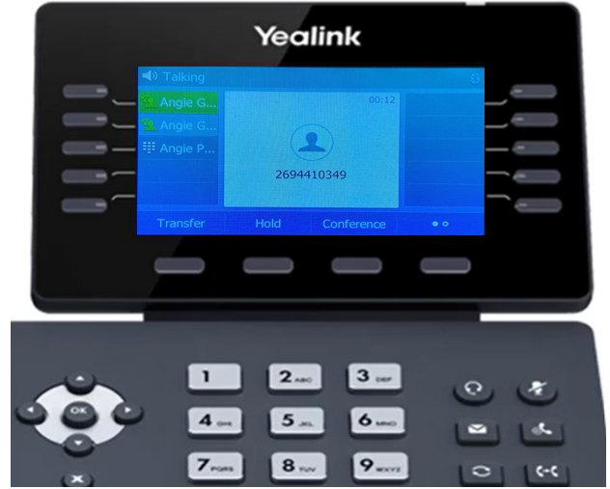
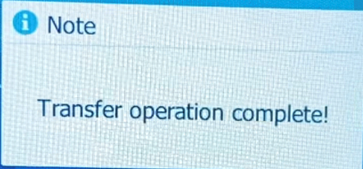
Transferring Calls
There are two types of Transfer you can use.
Consultative Transfer
Allows you to announce the call before passing the caller.
Displays your caller id to the recipient.
Blind Transfer
Passes the call to the recipient immediately.
Displays the caller’s caller id to the recipient.
For either function, begin by pressing the Transfer soft key or hard key.
Confirmation of completion will display.
Notes:
Once you press Transfer, you will see the options at the bottom of the screen change to offer options. NOTE: I AM ONLY ABLE TO BLIND TRANSFER ON MY T54W. PRODUCT DEVELOPMENT AWARE OF ISSUE. WE DO NOT HAVE THE ISSUE IN THE CTS HPBX.

Slide 10
Conference Calling
This feature allow you to join two other callers onto the same call with you.
With one active call, press Conference soft key.
Dial the third party
Press the Conference soft key
Notes:
This needs to be resolved. I am not able to conference on my T54W. Product Development was informed of this on 2/11/22.

Slide 11
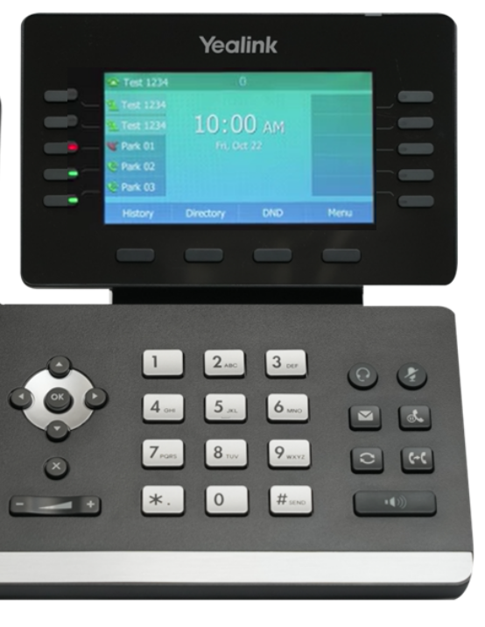
Call Park
As mentioned previously, Call Park is used as a “global hold” for your business group.
A call can be placed on “hold” and that button will blink on all phones.
To pick up that call from another phone, simply touch that park button and the call will be placed as an active call on your line.
Notes:
Call Park can be used in place of internal transfer, placing the call on Park and letting your peer know they have a call on Park 01 (or whichever orbit). Staff members need to understand that just because they see it blinking on their phone doesn’t mean the call parked is for them. When a call is placed on a park orbit, there is a built in timer (CTS is 2 minutes / MetroNet is 1 minute). If not picked up will ring back to the phone that placed the call on park. That ringback call will not go into that voicemail if unanswered so it is important to pay attention to the call if you are the one that parked the call.

Slide 12
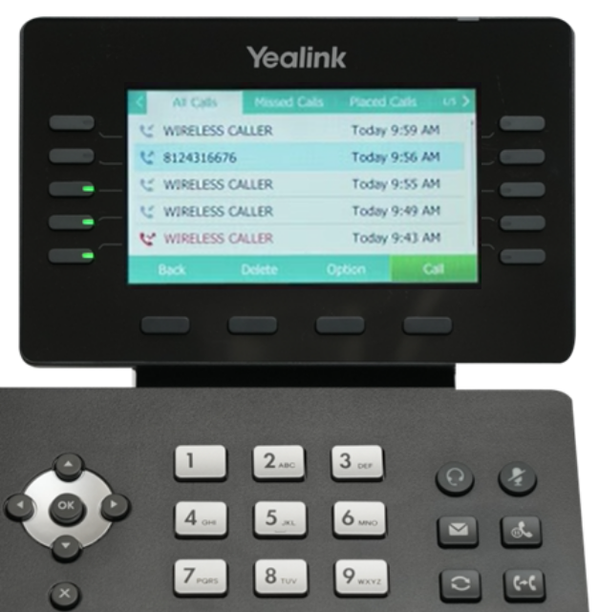
Call History
Your Missed Calls, Placed Calls and Received Calls are located in your Call History.
From here you can return calls and also clear out any missed calls that will be identified a notification.
Calls from your History can also be pulled into any contacts you wish to store in your Directory for future use.
Notes:
Call History is helpful if you need to return a call but don’t have the caller’s number. If you see the number in your history, you just touch that entry and your Yealink will dial that number. If you want to add the entry into your Directory, from your History, navigate to the entry and press the Option button at the bottom of the screen then select Add to Contacts. Also, this is where you will need to go to view your missed calls to reset your missed call notification. Missed call notification can be a pop up on your screen, your blinking LED light.

Slide 13
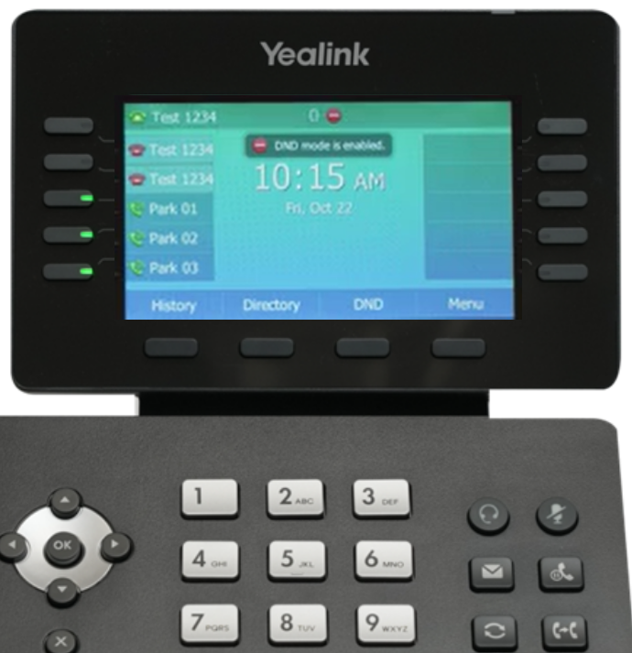
Do Not Disturb - DND
When DND is activated, your phone will not ring and all calls will automatically go to your voicemail.
To activate, press the DND button at the bottom of your screen. Your screen will display that your phone is in DND at the top of the screen and the icon next to your line.
To disable, touch the DND at the bottom of the screen.
Notes:
(Self explanatory)

Slide 14
Additional Resources
For Business Technical Support, call 883-393-6857
For Business Customer Service, call 855-769-0936
https://business.metronetinc.com/wp-content/uploads/Yealink_T54W_Desk_Phone_Instructional_Video/story.html
Notes:
In addition to the other materials emailed to you prior to this session, there is a great video library in the above link. As you can see, there is a menu of individual videos if you need to see how something specific is done which only takes a couple of minutes. If you don’t already have the toll-free number for Business Technical Support, make note of the above numbers. (I would email this link to the customer also)

